Slide 1
Virtuel Instrumenation: LabVIEW Introduction 7
Esben Søvsø Szocska Hansen, MSc Email: esben@mr.au.dk, Tlf.: +45 222384018

Slide 2
Useful tools and structures in LabVIEW

Slide 3
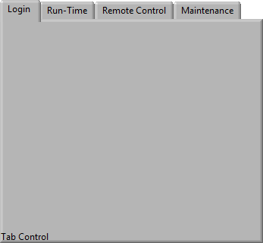
Tab Control
Add pages
Enum Control
Property Node for further control

Slide 4
Property Node
Modify and customize controls
1 - Create by right-clicking on control
2 – Create ref from control and land core property node
Contains control specific parameters

Slide 5
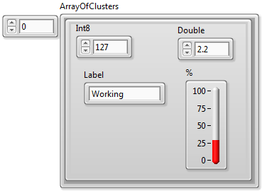
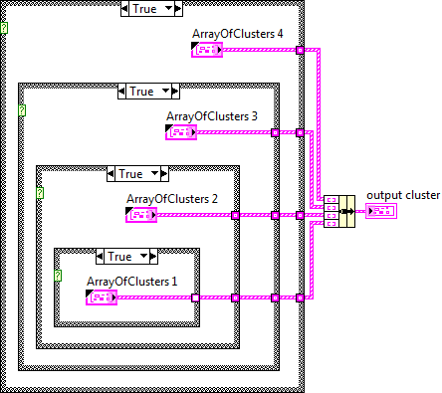
Typ Def
Create name – Custom Control
A must in larger setups
Updates from definition
Typdef
Strict Typdef
Ranges
Enums
…

Slide 6
7.1– Tablet Machine
7.1.1 – Tablet Custom Control
7.1.2 – Tablet Machine
*7.1.3 – Temperature alert and date alert

Slide 7
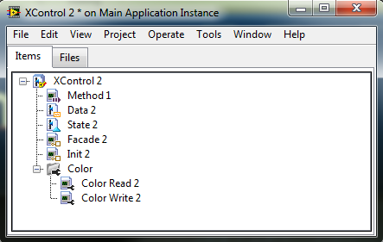
XControl
Used for design of more complex custom control
Dynamic run-time and edit-time behavior
Script like control and indicator

Slide 8
7.2– XControl
7.2.1 – Xcontrol – Temperature to Pressure modification

Slide 9
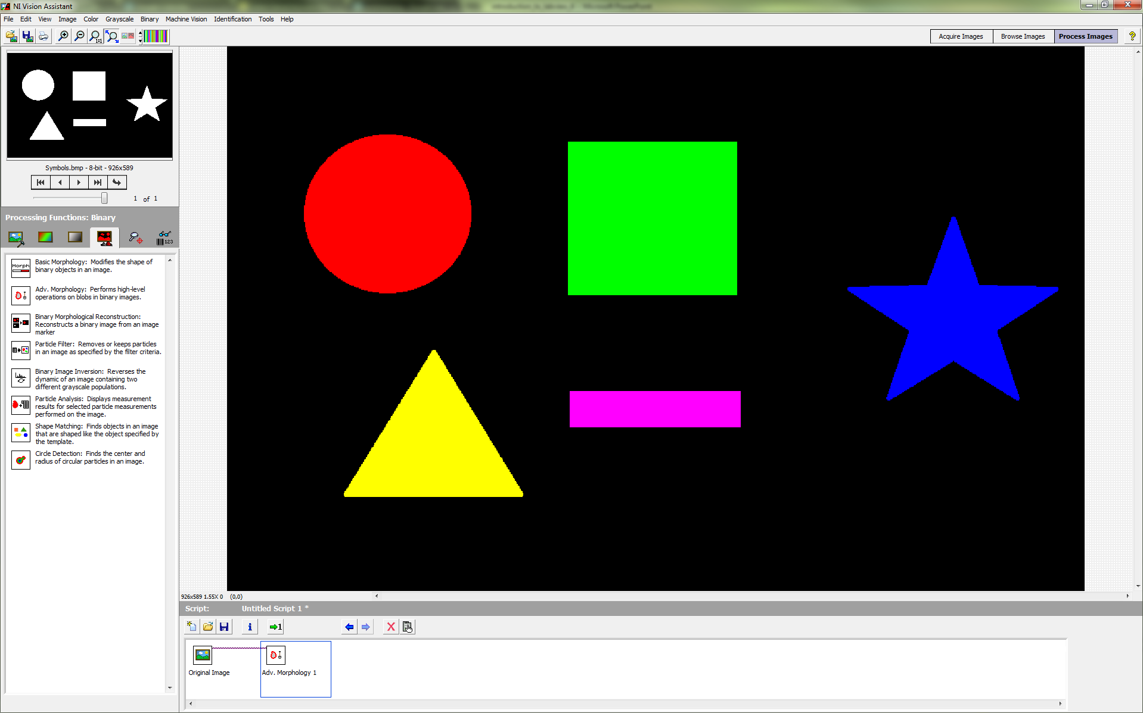
NI Vision Assistant
Rapid prototyping of vision control systems and image processing
Easy to implement
Script to LabVIEW VI compiler

Slide 10
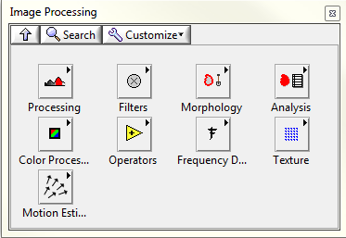
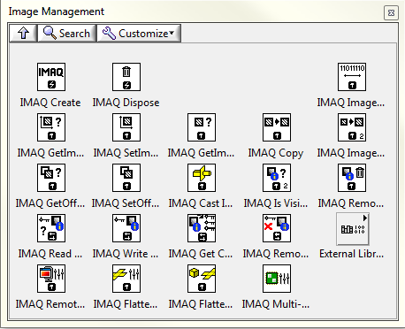
NI IMAQ toolbox
Adv. functions for image processing and vision systems
LabVIEW memory
Use error wire to control processing steps
Input image will be replaced in processing steps unless else stated

Slide 11
7.3– IMAQ
7.3.1 – Tablet Example One
7.3.2 – Tablet Example Two

