Slide 1
Virtuel Instrumentering: LabView Introduction 3
Samuel Alberg Thrysøe, PhD, PostDoc, Kontakt info: Email: sat@iha.dk, Tlf: +45 25533552

Slide 2
Repetition

Slide 3
Plotting data with irregular spacing
Waveform Chart
Waveform Graph
XY Graph
Indicator Graph

Slide 4
Plotting data with an offset and regular spacing delta X
Waveform Chart
Waveform Graph
XY Graph
Indicator Graph

Slide 5
Plotting data with continual updating
Waveform Chart
Waveform Graph
XY Graph
Indicator Graph

Slide 6
Controlling program flow: Case structures

Slide 7
Case Structures
Have one or more sub-diagrams (cases)
Only one will run when the structured is called
The control wired to the selector input chooses which case to run
Can be Boolean, string, integer, enum etc.
Right-click on the structure border to remove/add cases

Slide 8
Case structures

Slide 9
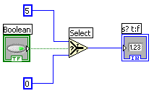
Select Function
Return the T(rue) value, if the boolean input is true
Returns the F(alse) value, if the boolean input is False

Slide 10
3.1 – Cases
3.1.1 - Temperature Case
3.1.2 – Dice Throw Response
3.1.3 – Square Root
*3.1.4 - Addition/Subtraction

Slide 11
Controlling program flow: Select structures

Slide 12
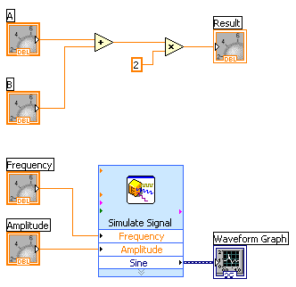
Which block runs first?
Block 1
Block 2
They run simultaneously
1
2

Slide 13
Dataflow Programmering
Block Diagram Execution
Depends on the dataflow
Does NOT execute left to right/top to bottom
A node is executed when data is present at ALL the inputs
Nodes pass data to the output terminals when they are done

Slide 14
Sequence Structures
Controls dataflow in VI block diagrams
Divides VI into frames
Looks like celluloid film
Flow passes from frame to frame when all the nodes in the individual frame are done
Drawn like loops and case structures
Right-click the border to add/remove frames
Two types of sequence structures:
Flat
Provides better overview
Stacked
Like case structures
Gives the opportunity to use local sequence variables

Slide 15
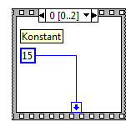
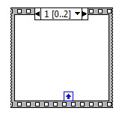
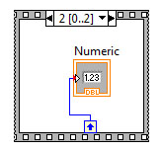
Sequence structures
Flat structure
Stack structure

Slide 16
Local variables
You can read from / write to controls and indicators everywhere in the sequence diagram
Right-click the icon and choose:
Create → Local variable
Right-click the local variable to switch between
Read
Write

Slide 17
3.2 – Sequencestructures
3.2.1 – Response Time
*3.2.2 - Time to Match 2

Slide 18
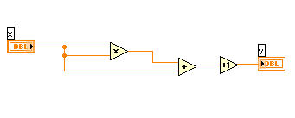
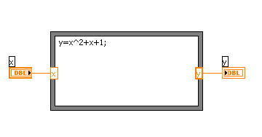
Formula nodes
A formula node contains … Formulas!
Y=x^2+x+1 on a normal block diagram:
And as a formula node:

Slide 19
Creating a formula node

Slide 20
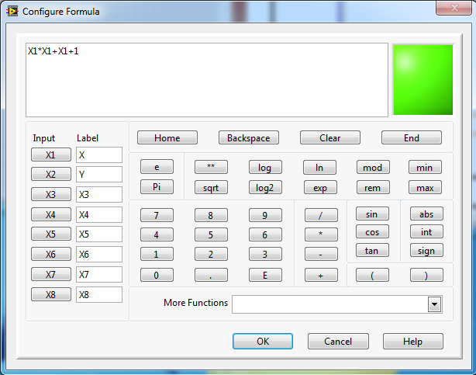
Another way to create a formula
Use the Formula Express VI
Express -> Arithmetic & Comparison -> Formula
Write the formula using the inputs, which you can label
Wire the in-/outputs on the Block Diagram

Slide 21
3.3 – Formula Nodes
3.3.1 - Temp Conversion 2

Slide 22
Sub VIs

Slide 23
Sub VIs
Collections of code
Low-level VI inside high-level VI
Reduces the number of Block Diagram nodes
Increases readability
Modular approach
Analogue to functions in text-based languages

Slide 24
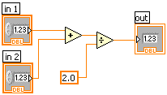
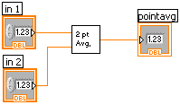
LabView SubVIs ~ Functions
Function Pseudo Code
function average (in1, in2, out)
{
out = (in1 + in2)/2.0;
}
SubVI Block Diagram
Calling Program Pseudo Code
main
{
average (in1, in2, pointavg)
}
Calling VI Block Diagram
Notes:
A subVI node corresponds to a subroutine call in text-based programming languages. The node is not the subVI itself, just as a subroutine call statement in a program is not the subroutine itself. A block diagram that contains several identical subVI nodes calls the same subVI several times.
The modular approach makes applications easier to debug and maintain.
The functionality of the subVI does not matter for this example. The important point is the passing of two numeric inputs and one numeric output.
Introduction to LabVIEW Hands-On 42 ni.com

Slide 25
Creating SubVIs
2 methods
Create a blank VI and insert the wanted nodes
Mark a number of nodes in the Block Diagram and choose Edit -> Create SubVI
Controls → Inputs
Indicators → Outputs

Slide 26
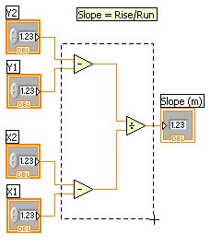
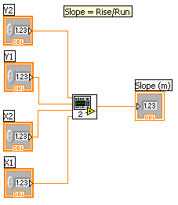
Creating SubVIs
Mark the area, to be turned into a SubVI
Choose Edit → Create SubVI
Notes:
© National Instruments Corporation 41 Introduction to LabVIEW Hands-On

Slide 27
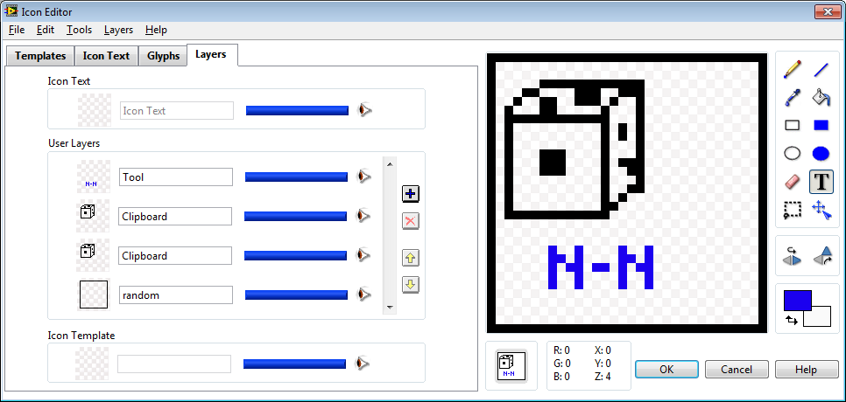
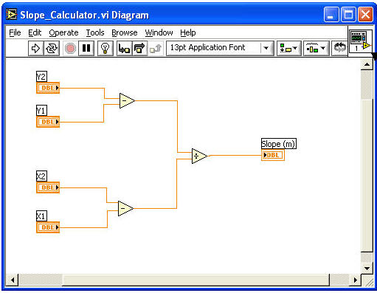
Changing the Icon
Important to differentiate the SubVIs
Right-click the standard-icon to the top right on the Block Diagram and choose: Edit Icon

Slide 28
Changing the Connections
Right-click the VI icon to the top right on the Front Panel and choose: Show Connector
The Icon changes to connector
Edit the terminals by right-clicking the connector and choose Add/Remove Terminal
Or choose standard configurations
Right-click Connector -> Patterns
Connect inputs (left) with controls
Connect outputs (right) with indicators

Slide 29
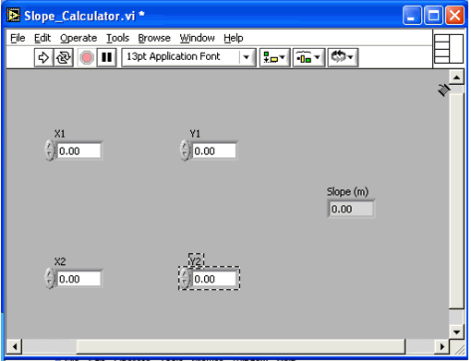
Changeing the Connections

Slide 30
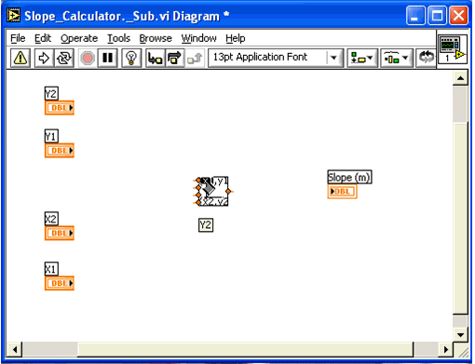
Connect SubVIs in the Block Diagram
The terminals are named according to the names of the controls/indicators in SubVIs

Slide 31
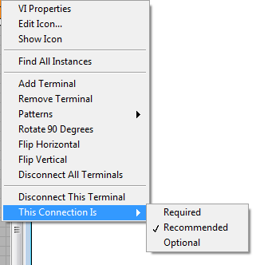
Connection Properties
Connections can be
Required
Recommended
Optional

Slide 32
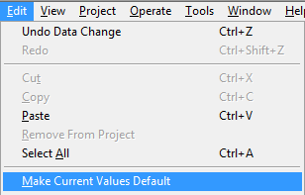
Default values
The values of controls can be set to standard
Edit -> Make Current Values Default
These are used, if the input is not connected

Slide 33
SubVIs
TempConversion.vi

Slide 34
3.4 – SubVIs
3.4.1 – Choose Column
3.4.2 - DiceThrows3_SubVIs
*3.4.3 - Random LED_SubVI

Slide 35
Cluster Data

Slide 36
LabView Clusters
Analogue to Structs in C++ / Matlab
Combines one or more data types in a single structure
Eg boolean, strings and integers
Reduceres the complexity of block diagrams
Unbundle gives access to the individual elements

Slide 37
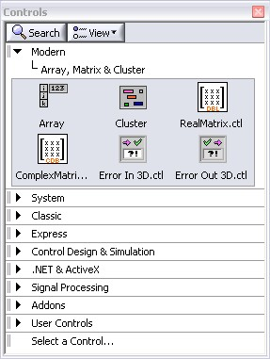
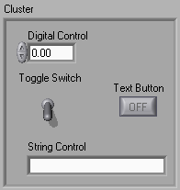
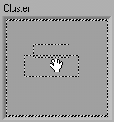
Creating Clusters
Create a cluster shell
Using same approach as case structures and loops
Controls -> Modern -> Array, Matrix & Cluster

Slide 38
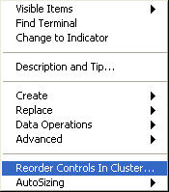
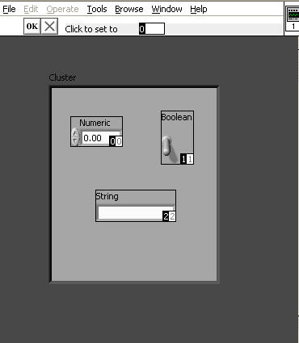
Cluster Ordering
Changing the order of cluster components:
Right-click the border of the cluster on the Front Panel
Choose ”Reorder Controls In Cluster…”
Two boxes will appear on all the cluster components
White = Current position
Black = New position
To move a component:
Choose the top space
Click on the control
1
2

Slide 39
Cluster Order
ClusterOrder

Slide 40
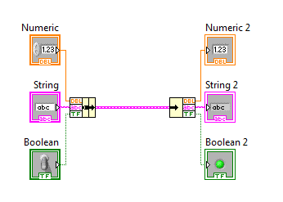
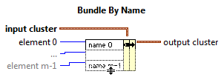
Bundle / Unbundle
Updates specific cluster object values
Returns the cluster elements named
Terminal labels reflect the data type

Slide 41
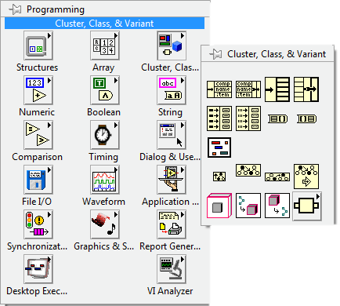
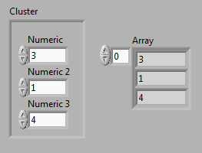
Cluster <-> Array
You can change between clusters and arrays IF
All cluster components have the same data type
All are boolean/numeric/string etc.

Slide 42
3.5 – Clusters
3.5.1 - Cluster IO
3.5.2 - Cluster Bundling
*3.5.3 – Login

