Slide 1
Virtuel Instrumentation: LabView Introduktion 2
Samuel Alberg Thrysøe, PhD, Assistant Professor, Contact info: Email: sat@iha.dk, Phone: +45 25533552

Slide 2
Repetition

Slide 3
Where do you ”program” in LabView?
Front Panel
Block Diagram

Slide 4
Where would you insert Waveform Charts?
Front Panel
Block Diagram

Slide 5
Which of these is an indicator?

Slide 6
Which of these is an Express VI?

Slide 7
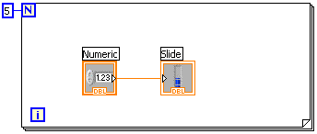
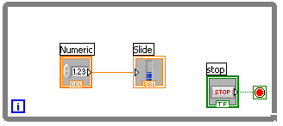
Which is the For Loop?

Slide 8
What is this structure?
Loop Tunnel
Indekseret Tunnel
Shift register
IO Thread

Slide 9
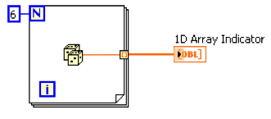
What is this structure?
Loop Tunnel
Indekseret Tunnel
Shift register
IO Thread

Slide 10
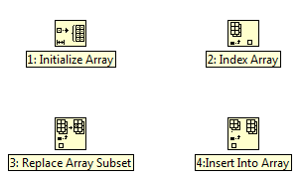
Which function can return a value from an Array element?

Slide 11
Which function inserts a value into an Array?

Slide 12
LabView Graphs

Slide 13
Waveform Charts Updating
Strip Chart
Like paper strip
Data scrolls to the right, when it reaches right side, old data are pushed out to the left
Scope Chart
When data reaches right side, the display is blanked and the plot restarts
Sweep Chart
Like the Scope Chart, but instead of blanking the display, a vertical line is shown drawing the data

Slide 14
Waveform Charts vs Graphs
Waveform Chart
Waveform Graph
One datapoint at a time
Shows history of received values
The chart is updated whenever a new datapoint is received
Only receives data
X-axis is time
Shows many datapoints at a time
Shows data arrays
The graph is updated when alle datapoints are available
All points plotted simultaneously

Slide 15
Waveform Graphs
Receives data in the form of
Initial X-value
Delta X
Y data
Numerical array
Can also just receive Y-data
Initial X-value is 0 by default
Delta X is 1 by default

Slide 16
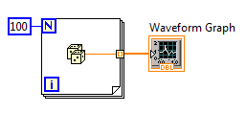
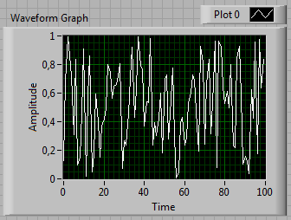
Waveform Graphs
Delta X = 1 (default)
Starts at 0 (default)

Slide 17
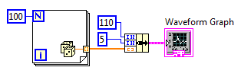
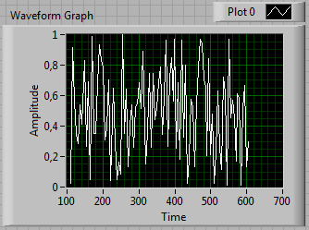
Waveform Graphs
Delta X = 5
(max = 5*100 + 110)
Starts at 110

Slide 18
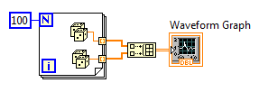
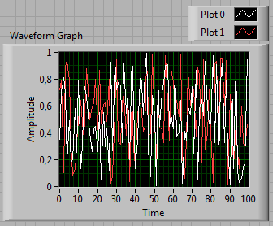
Waveform Graphs
Build Array
Delta X = 1 (default)
Starts at 0 (default)

Slide 19
XY graphs
Cartesian plots
Waveform graphs
Plots data with constant sampling
Eg every 5 seconds
XY graphs
Plots X,Y coordinates
Expects inputs of bundled X + Y arrays

Slide 20
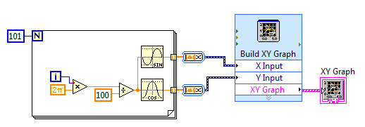
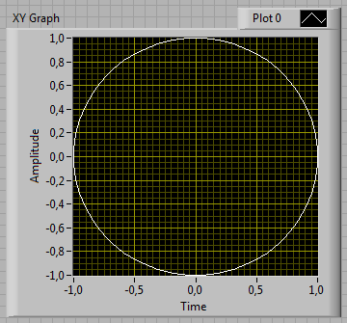
Express XY graphs
Front panel ->
Graph ->
Express XY Graph

Slide 21
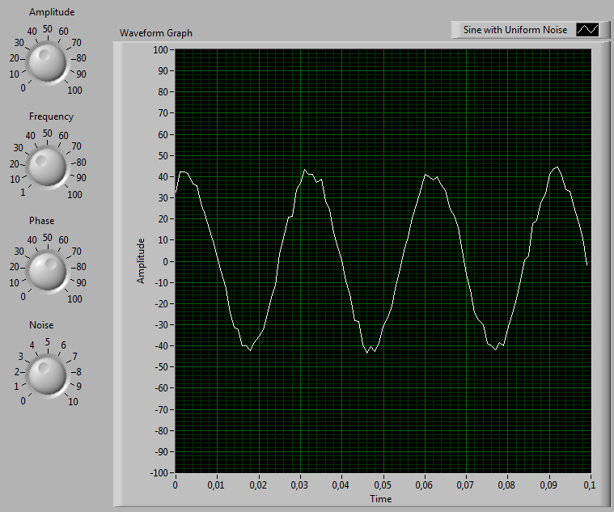
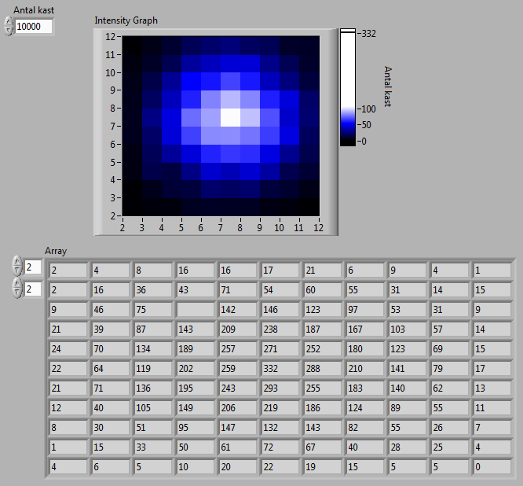
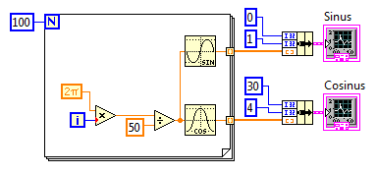
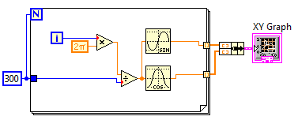
2.1 – Graph Exercises
2.1.1 – Waveform Graphs
2.1.2 – Sine and Cosine
2.1.3 – XY Graphs
*2.1.4 – Dice Throws 3

Slide 22
LabView File I/O

Slide 23
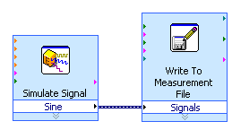
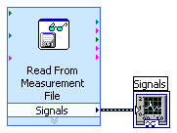
LabView File I/O
Read/write formats
Binary
Text
Spreadsheet
LabView Measurements File (*.lvm)
Write to LVM file
Read from LVM file

Slide 24
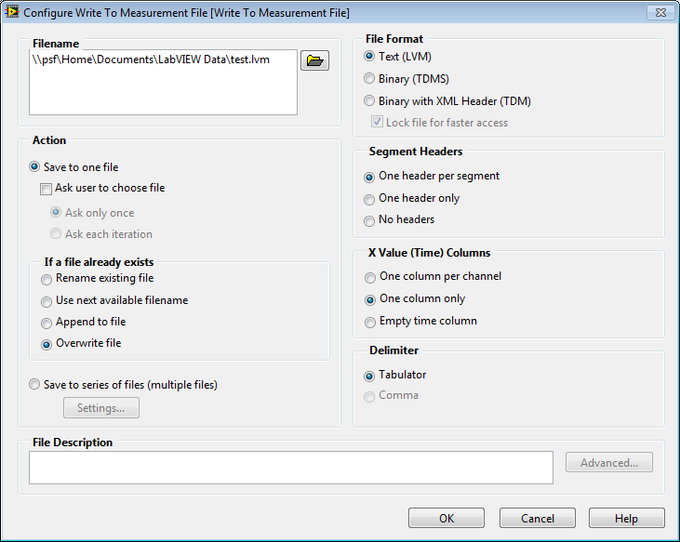
Write to LVM file

Slide 25
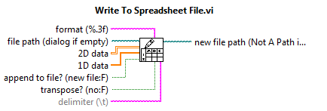
Write to Spreadsheet

Slide 26
2.2 – File I/O
2.2.1 – Save to LVM
2.2.2 – Save to Spreadsheet
*2.3 – Advanced Graphs
*2.3.1 – Sampling and Reconstruction
*2.3.2 – Lissajous Curves
*2.3.3 – Eindhovens Triangle

